Slide 1

MARKETS
Markets

Slide 2
Onion Prices-2019
Onion prices jumped up to 76% in last one month due to reduction in arrivals in the agricultural mandis across the country, following floods in major supplying states such as Maharashtra, Karnataka and Madhya Pradesh.
In the benchmark Lasalgaon mandi, Asia’s largest onion selling wholesale market, onion prices shot up by 71 per cent to trade at Rs 20.50 a kg on August 20 from a Rs 12 a month ago.
In this market, however, farmers ramped up supply to take advantage of the current price rise, which they say they have seen after several years. Total onion arrivals in Lasalgaon mandi jumped to 2,545 tonnes on August 20 from about 1,500 tonnes a month earlier (Business Standard,Aug 22,2019) .

Slide 3
Mobile Phones
“We have been witnessing a sudden increase in demand for refurbished phones in the last two-three days,” said Nakul Kumar, chief operating officer of Cashify. “But fulfilment is becoming an issue since the supply is quickly drying up for us as well. The Economic times, June 28-20

Slide 4
Markets
Market is a group of buyers and sellers of a particular good or service.
Two Types of Market
1. Competitive Market or Perfect Markets
2. Non Competitive or Imperfect Markets
Competitive Market –
Many buyers and Sellers
Homogeneous product
Price Takers

Slide 5
Non Competitive or Imperfect Markets
Is one in which the buyer or seller has influence on the market price.
Few Sellers
Unique product or differentiated product
Price Makers
Three Different Types
Monopoly
Monopolistic Competition
Oligopoly

Slide 6
Demand and Law of Demand
Demand is willingness and ability to buy the product.
According to Law of Demand, all other things equal, quantity demanded falls when price rise, and rises when prices fall.
Inverse relationship between Price and Quantity Demanded.

Slide 7
Demand Schedule
Price of Commodity A | Quantity Demanded
20 | 0
17.50 | 1
15 | 2
12.50 | 3
10.00 | 4
7.50 | 5
5.00 | 6
2.50 | 7
0.00 | 8
A demand schedule a table that shows the relationship between the price of a good and the quantity demanded.

Slide 8
Demand Curve
Horizontal axis measures Quantity demanded
Vertical axis measures price
Demand Slopes downwards
Inverse relationship between quantity demanded and Price
Qd = a – bP

Slide 9
Demand Equation
Qd = a – b(P)
Q = quantity demand
a = all factors affecting price other than price (e.g. income, fashion)
b = slope of the demand curve
P = Price of the good.
Inverse demand equation
The inverse demand equation can also be written as
P = a -b(Q)
a = intercept where price is 0
b = slope of demand curve
Q = quantity demanded

Slide 10
Market Demand
Price | Person A | Person B | Person C
20 | 0 | 0 | 0
17.50 | 0 | 1 | 1
15 | 1 | 2 | 3
12.50 | 1 | 3 | 4
10.00 | 2 | 4 | 6
7.50 | 2 | 5 | 7
5.00 | 3 | 6 | 9
2.50 | 3 | 7 | 10
0.00 | 4 | 8 | 12
Market demand is the sum of all individual quantities demanded by each buyer in the market at each price.

Slide 11
Shift in Demand Curve
Price factor- Movement along the demand curve
Non Price Factors-Shifts the demand curve
Changes in Income
The Price of Related goods
Substitute goods
Complementary Goods
Changes in Tastes and Preferences
Expectation regarding future prices
The Number of Buyers
Case of Italy-market for baby equipment, Market for health care.

Slide 12
Substitute and Complementary Goods
Substitute Good
Complementary Goods
Two goods A and B
When Price of Good A increases the Quantity demanded for good B increases.
A and B are substitute goods
Tea and coffee
Smartphone Brands
Rival ride sharing apps
Competing supermarket chains
Online streaming platforms
Cereal brands
When Price of Good A increases the quantity demanded for Good B decreases. A and B are complementary goods.
Consume together
Smartphones and apps
Solar panels & batteries
Flights and taxi services
Shoes and polish
Pasta and pasta sauces

Slide 13
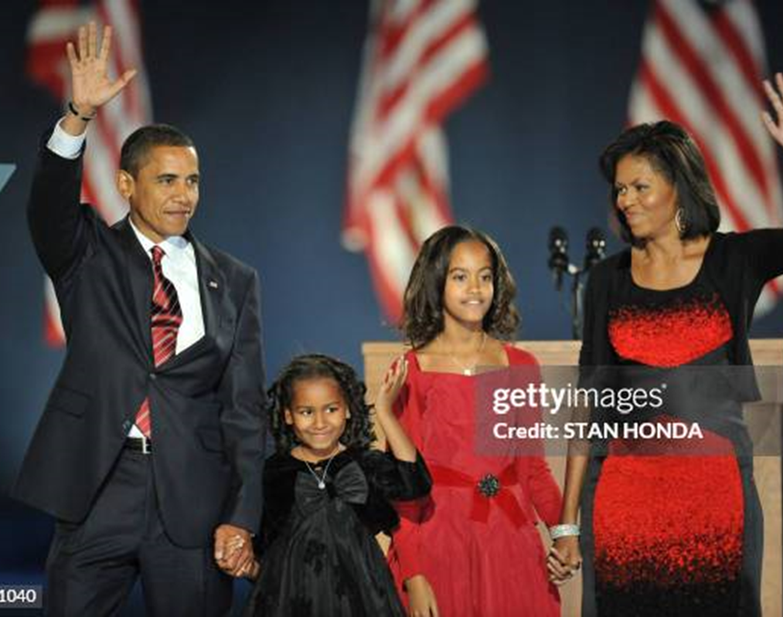
The Price of Fame: President Obama and the Paparazzi
Being President of the United States has its perks-
You are the most powerful person in the world.
People wait on you and foot
You get to live in a pretty nice house rent free.
But being President has its downsides.

Slide 14

Figure 3 Shifts in the Demand Curve
Price of
Ice-Cream
Cone
Increase
in demand
Decrease
in demand
Demand
curve,
D
2
Demand
curve,
D
1
Demand curve,
D
3
0
Quantity of
Ice-Cream Cones
Copyright©2003 Southwestern/Thomson Learning

Slide 15
Supply and Law of Supply
Supply is willingness and ability to sell the product.
According to Law of supply, holding all other factors equal the quantity supplied of a good increases when the price of good rises, and falls when the price of goods falls.

Slide 16
Supply Schedule
Price | Quantity supplied
20 | 800
17.50 | 700
15 | 600
12.50 | 500
10.00 | 400
7.50 | 300
5.00 | 200
2.50 | 100
0.00 | 0
Supply schedule is a table shows the relationship between the price of a good and the quantity supplied.

Slide 17
Supply Curve
Vertical axis measures price and horizontal axis measures quantity supplied.
Supply curve slopes upwards
Positive relationship between price and quantity supplied.
Qs= c+dP

Slide 18
Market Supply
Price | Person A | Person B | Person C
20 | 200 | 800 | 1000
17.50 | 175 | 700 | 875
15 | 150 | 600 | 750
12.50 | 125 | 500 | 625
10.00 | 100 | 400 | 500
7.50 | 75 | 300 | 375
5.00 | 50 | 200 | 250
2.50 | 25 | 100 | 125
0.00 | 0 | 0 | 0
Market supply is the sum of the quantities supplied by each seller in the market at each price.

Slide 19
Shifts in Supply Curve
Price factor-Movement along the supply curve
Non Price Factor-Shifts the supply curve
Cost of inputs
Changes in Technology or the production process
Taxes and subsidies
The Number of Firms in the Industry
Price Expectations

Slide 20
Oil Firms to get Rs. 30,000 Cr. For Subsidised LPG
The Union Cabinet on Aug 9, 2025 approved compensation worth Rs. 30000 cr to be paid to three public sector oil marketing companies (OMCs) for subsidising the sale of cooking gas at a time of soaring global prices.
Cabinet approved targeted subsidy of Rs. 300 per 14.2 Kg gas cylinder for up to nine refills per year to the poor households.
The Bharat Petroleum Corporation Limited, Hindustan Petroleum Corporation Limited and Indian Oil Corporation Limited.

Slide 21
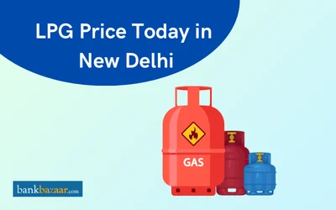
Fuel Breakdown
Price Charged to distributors | 739.3 | Retail Price Rs.853 | Subsidy Rs. 300
Distributors Commission | 73.08
Central GST @ 2.5% | 20.31
State GST @ 2.5% | 20.31

Slide 22
Figure 7 Shifts in the Supply Curve
Price of
Ice-Cream
Supply curve,
S
3
Supply
Cone
curve,
S
1
Supply
Decrease
curve,
S
2
in supply
Increase
in supply
0
Quantity of
Ice-Cream Cones
Copyright©2003 Southwestern/Thomson Learning

Slide 23
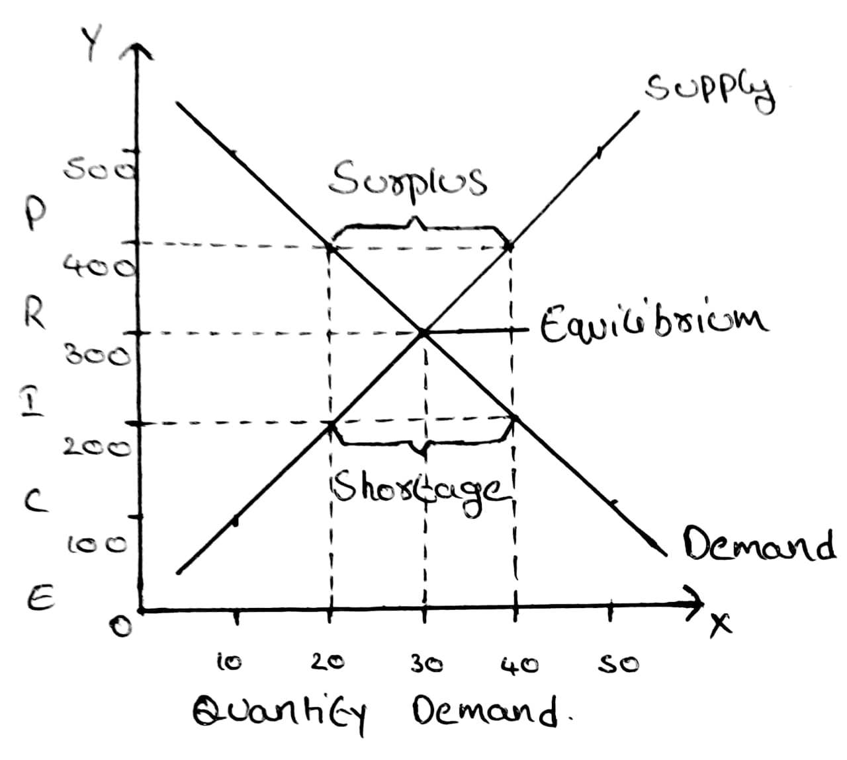
How do supply and demand shifts affect a market?

Slide 24
Market Equlibrium
Equilibrium occurs at the point where the demand curve and supply curve intersect.
Equilibrium price is the price at which the quantity supplied is equal to the quantity demanded. This is also known as market clearing price.
Equilibrium quantity is the amount at which the quantity supplied equal to quantity demanded.
Law of Demand and Supply states that the market price of any good will adjust to bring the quantity supplied and the quantity demanded into balance.

Slide 25
Shortages and Surpluses
Shortage occurs whenever the quantity demanded is more than the quantity supplied.
Surplus occurs whenever the quantity supplied is more than the quantity demanded.

Slide 26
Market Supply,Market Schedule and Equlibrium for Brown Bread
Price per packet of Brown Bread | Quantity Supplied per day( Million packets) | Quantity Demanded per day (million packets) | Surplus or Shortage | Pressure on Price
20 | 14 | 2 | 12 | Downward
15 | 10 | 4 | 6 | Downward
10 | 6 | 6 | 0 | Equlibrium
7.5 | 4 | 7 | -3 | Upward
5 | 2 | 8 | -6 | Upward

